Slide 1

CS410 Final Project – SeekFrame University of Illinois Urbana-Champaign
Team Members:
Manasa Gangaiah (manasag3@illinois.edu)
Sudhir Ponnachana (sudhirp2@illinois.edu)

Slide 2
Introduction
Overview
Architecture
Technology used
Runbook for hosting the application
References

Slide 3
Overview
Project Goals
Build a search engine that provides ranked list of videos that seeks to correct offset based on query words.
Motivation
Online education, like Coursera, is delivered through pre-recorded videos
Students view and learn through these video courses
Students intend to review certain section of the video in the course for test preparation or for revising the topic.
It takes time to look through videos to get to the right video frame containing the sub-topic.
Notes:
-

Slide 4
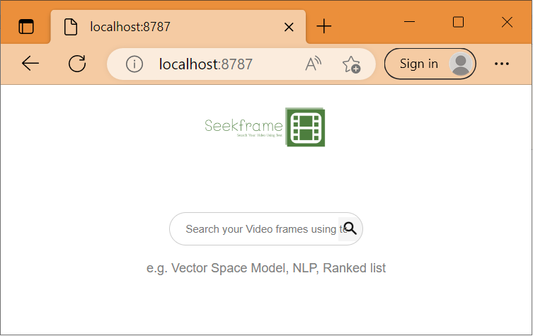
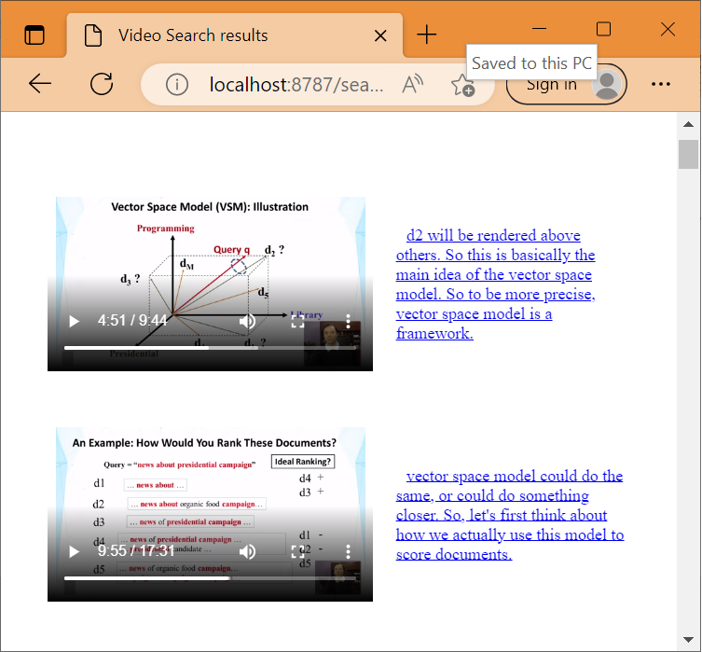
Architecture
Data
Web Server
(SeekFrame Engine)
Subtitles
(.vtt files)
Preprocess
Corpus
Routes
Get Videos
Serve Video
Videos
(.mp4 files)
Videos – mp4 files
(metadata at the start of the file)
Search Engine
Preprocess
Ranked list of Videos

Slide 5
Technology Used
Text Retrieval
BM25 Algorithm
Webserver
Bottle – Python Web Framework
Html
Python libraries – Pandas, gensim
Data Processing
Videos from Coursera – Curated
Accompanying Video Subtitles
Logo Generation
www.logo.com was used to generate the logo used in the project -

Slide 6
Data Pre-processing
Subtitles
Sample raw data
200:00:09.625 --> 00:00:12.226>> This lecture is about Natural Language
Curated sample data
1 9 This lecture is about Natural Language of Content Analysis. As you see from this picture, this is really the first step
Video
Used the tool from GitHub - danielgtaylor/qtfaststart
python -m qtfaststart 6.mp4

Slide 7
Runbook for hosting the application
Install the following packages on your Windows 10 System
Python - python (https://www.python.org/downloads/ )
Python Package Manager - python3-pip
Libraries
Pandas – Data Processing
pip3 install pandas
Gensim – Stopword removal
pip3 install gensim
rank_bm25 – BM25 Algorithm
pip3 install rank_bm25
Bottle and requests_html – WebServer
pip3 install requests_html
pip3 install bottle
Download the source code for the application from github
Location - https://github.com/mtest-oss/CourseProject
git clone https://github.com/mtest-oss/CourseProject.git
Download the Videos from – Google Drive to CourseProject\Data\Videos folder

Slide 8
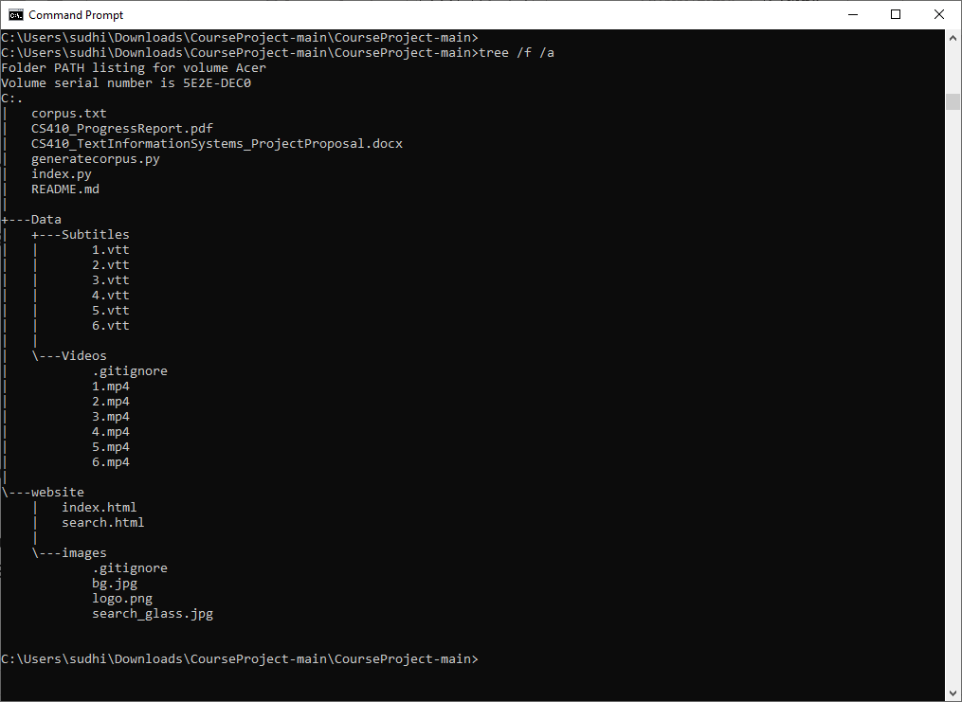
Runbook for hosting the application
Source code directory structure after the code is downloaded is shown here

Slide 9
Runbook for hosting the application Cont.
From command prompt do the following
cd CourseProject-main
dir to list the following files
generatecorpus.py
index.py
Run the command ‘python generatecorpus.py`
Run the command ‘python3 index.py’
Wait for the above command to print - “Listening on http://localhost:8787/
Use Microsoft Edge (preferred) to connect to the web server - http://localhost:8787/

Slide 10
Runbook for hosting the application Cont.
Connecting to the webserver using browser will show the search interface
Type in the search query – “Vector Space Model” and hit enter

Slide 11
Runbook for hosting the application Cont.
Web server for SeekFrame application will return a ranked list of Videos
Each Video link is offset to the frame containing the searched query

Slide 12
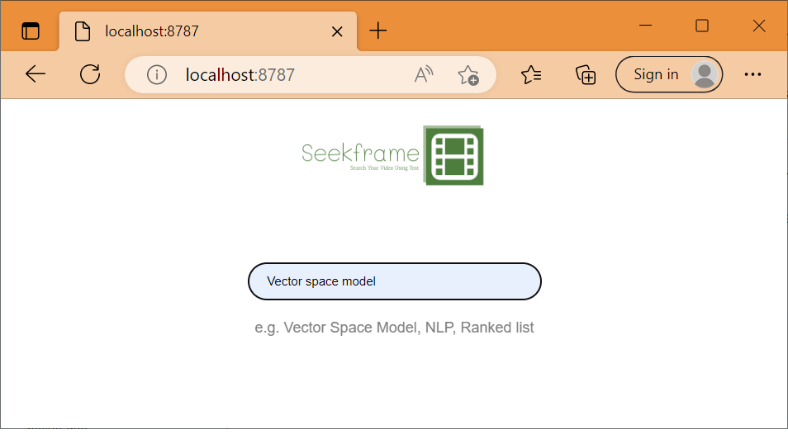

Test Case 1 and Result
Enter query words in the search box. It should list all the videos with matching query words with proper seek time

Slide 13
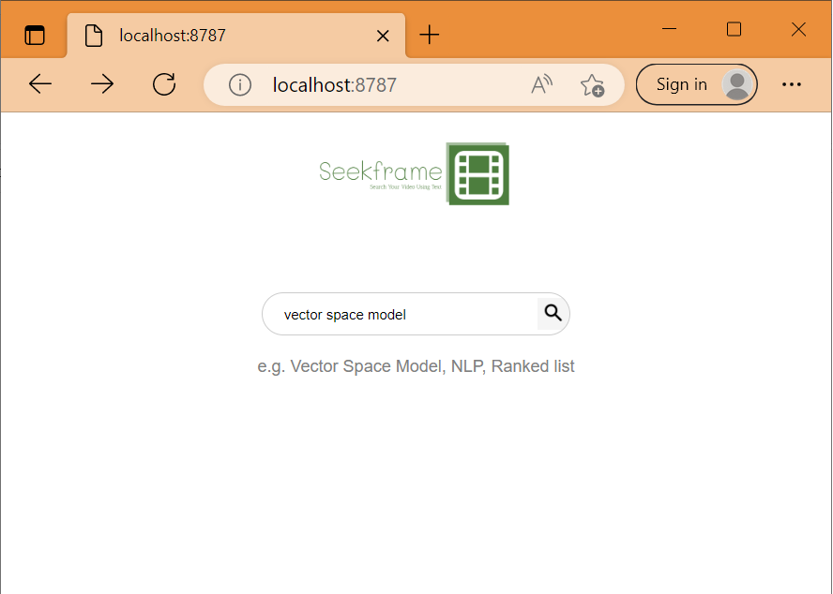
Test Case 2 and Result
Enter a query in upper case/lower case. Search will result in the same search items with proper seek time.

Slide 14
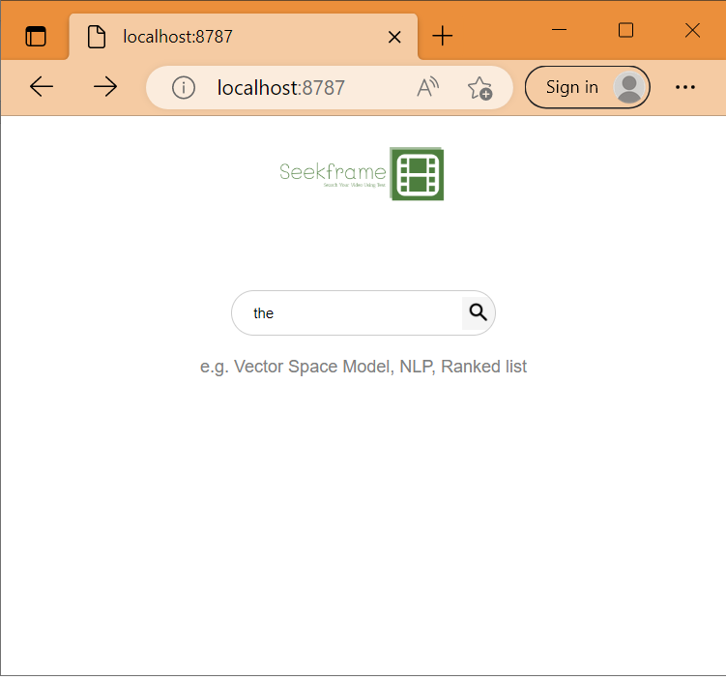
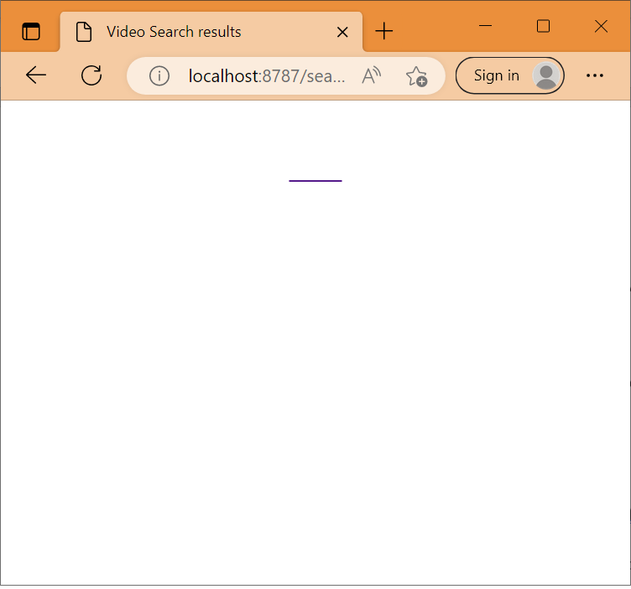
Test Case 3 and Result
Enter a stop word. Since we are filtering out the stop words, we don’t show any videos for that.

Slide 15
References
CS 410 Text Information Systems MP 2.4 - Generic BM25 idea
GitHub - danielgtaylor/qtfaststart: Quicktime atom positioning in Python for fast streaming
To preprocess the videos to have metadata at the beginning.
Tutorial — Bottle 0.13-dev documentation (bottlepy.org)
Python Programming Simple Web Server using Bottle Framework ( Day 5 ) – YouTube
BM25 | Build your Own NLP Based Search Engine Using BM25 (analyticsvidhya.com)

Slide 16
Thank You

